Slide 1
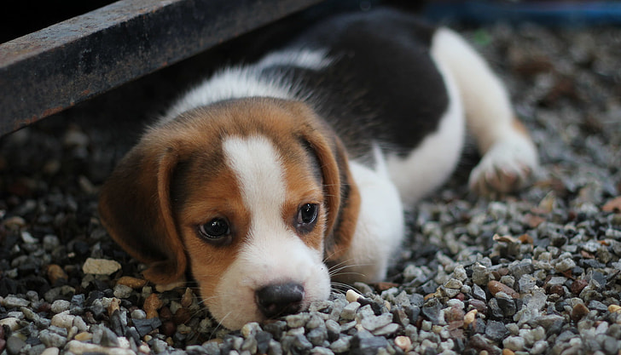
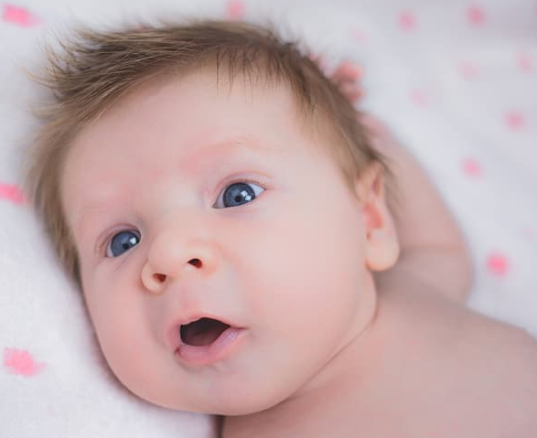
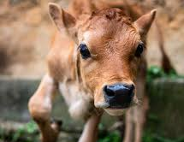
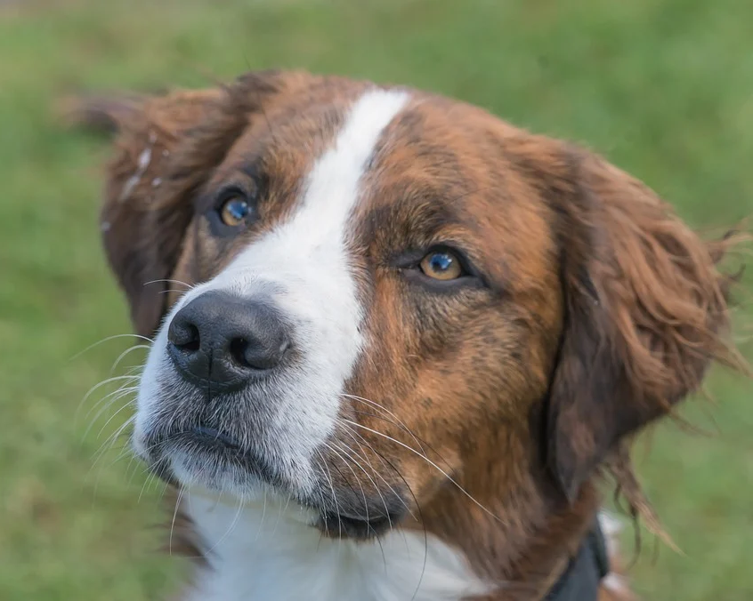
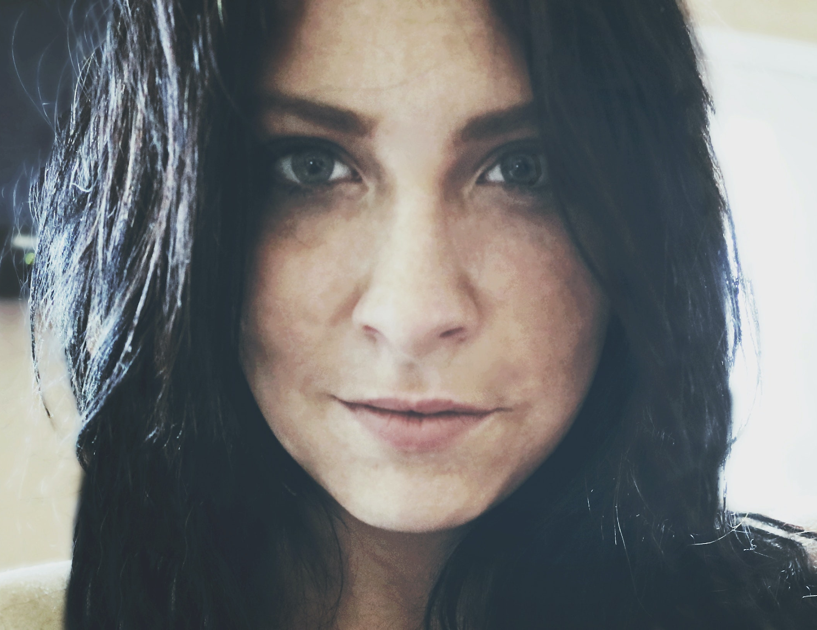
Growing Up
Starter --> Can you match the baby animals with the adults animals?
?
Notes:
Stick different adult and baby images on a board, flipchart or use an interactive whiteboard.
Ask the pupils to match up the adult animals and the baby animals - (this activity could be extended by asking pupils to bring images of their pets as babies and now or themselves now as a fun starter activity)

Slide 2
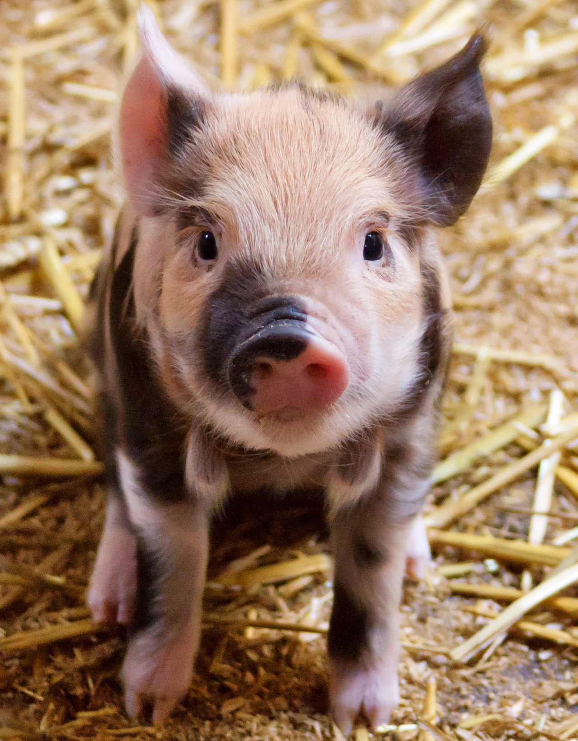
Baby Animal Names
Step 1: Some baby animals have special names - can you guess which animal I am talking about?
Cub
Calf
Lamb
Colt
Kid
Fawn
Tadpole
Step 2: Which baby animals look like their parents?
Step 3: Which baby animals look different from their parents?
Notes:
Point out that some baby animals have special names - can the pupils read or guess the name of each baby animal? (Can do this task as multiple choice to differentiate more)
Answers:
Bear, Lion, Tiger, Wolf, Fox - Cub
Elephant - Calf
Sheep - Lamb
Horse - Colt
Goat - Kid
Deer - Fawn
Frog - Tadpole
Ask pupils:
Which baby animals look like their parents? (can they list any?)
Which baby animals look different from their parents? (can they list any?)

Slide 3
Baby Animals
Step 4: Watch the following YouTube clip about baby and adult animals

Slide 4
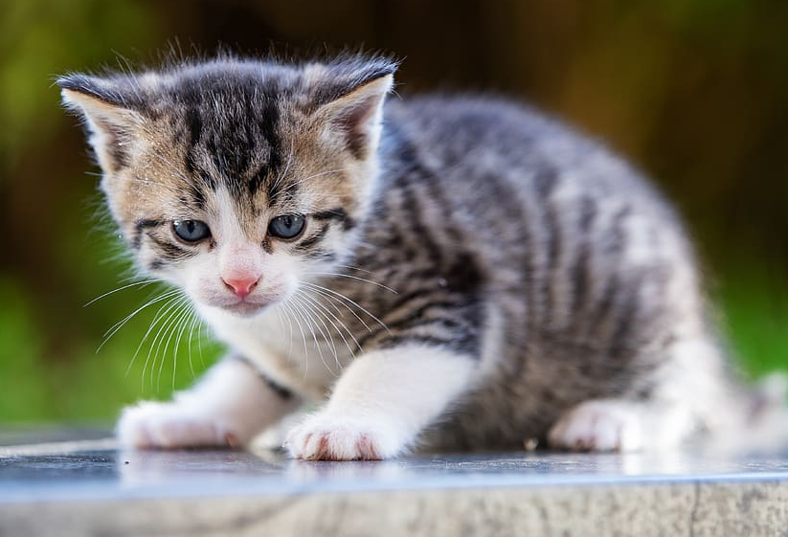
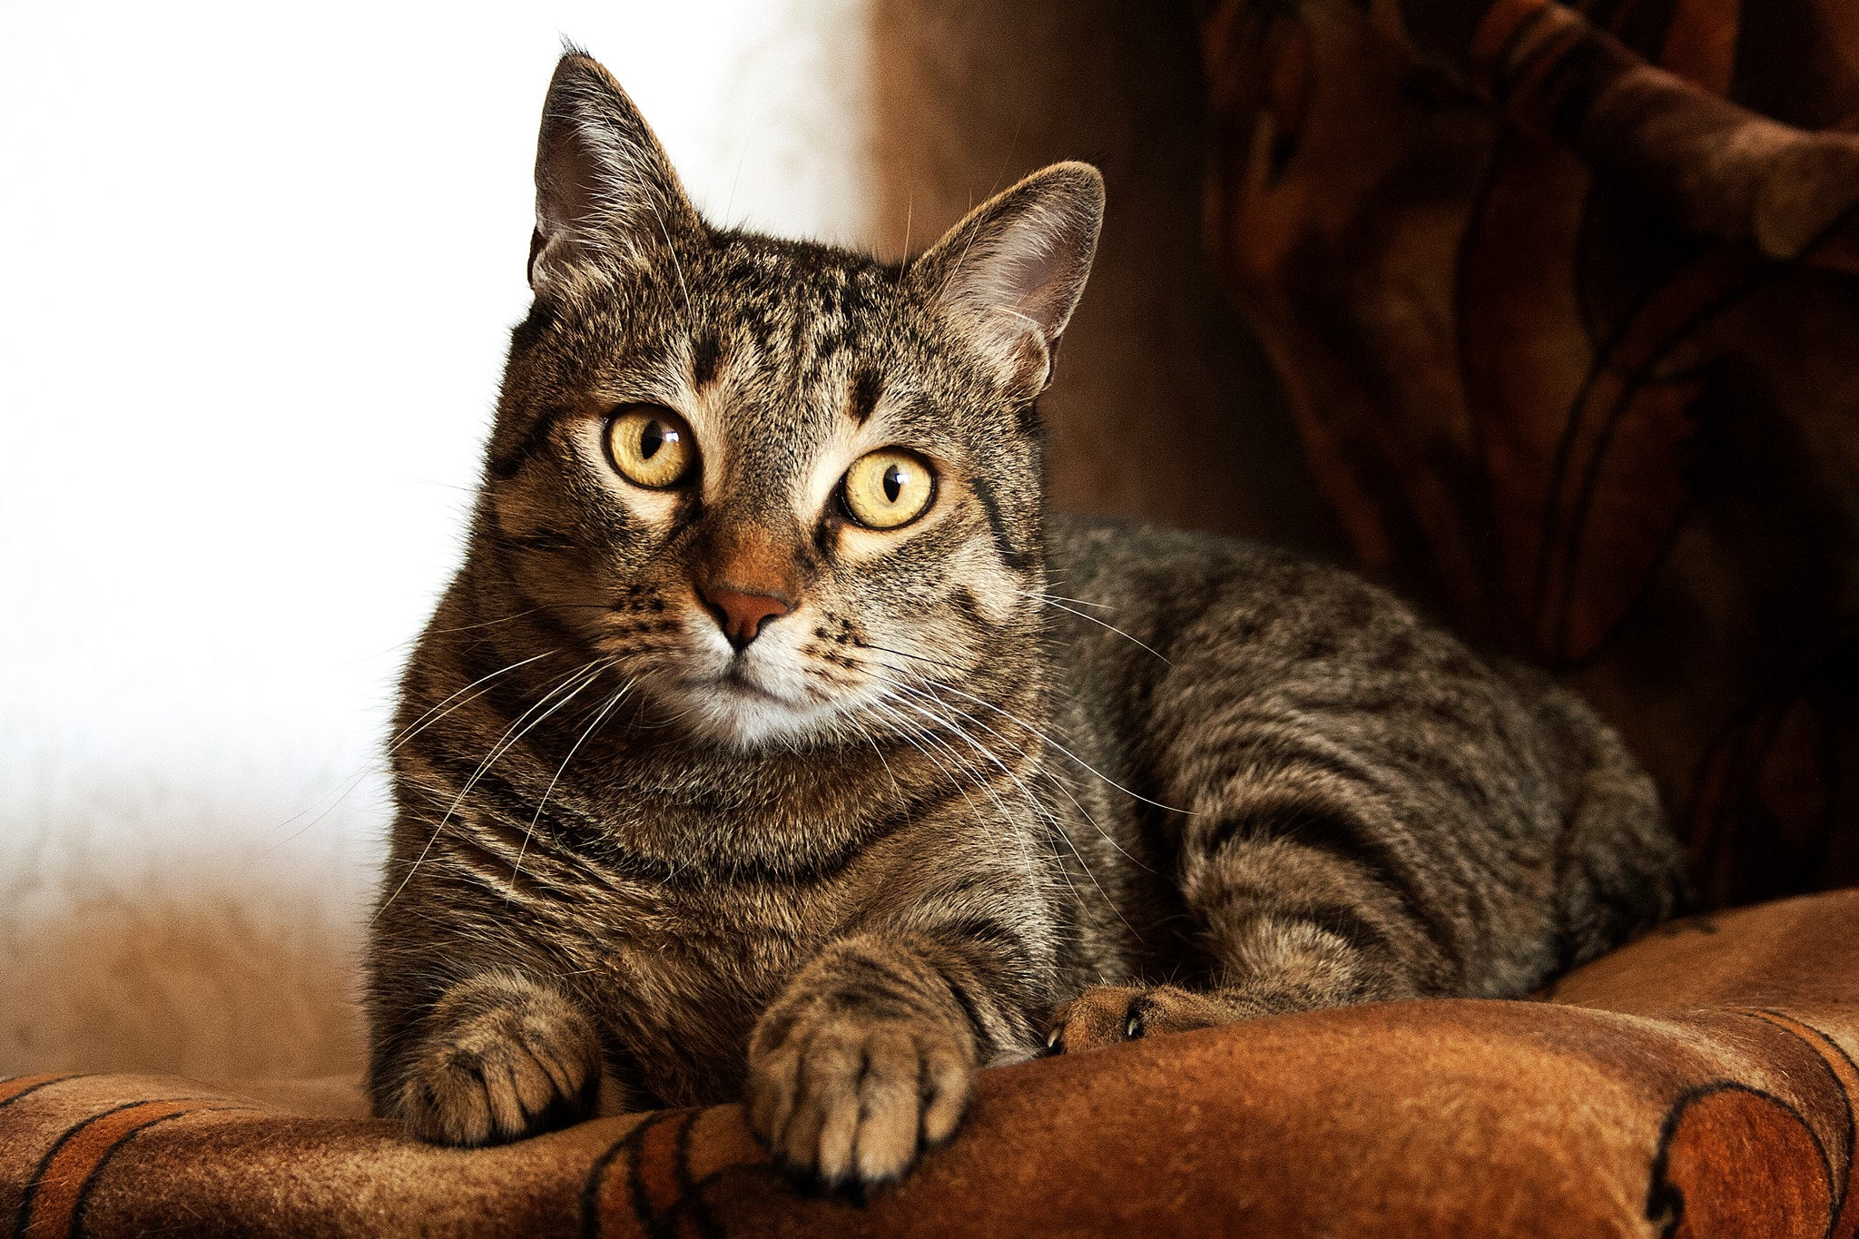
Baby Animal Care
Class Example: Kitten → Cat
Working in groups, you will each be given a baby animal.
How do you think this animal should be looked after?
Will it need the same things as a human baby?
Who looks after it? Is it the pet owner as well as the parent animal?
How do you think a kitten should be looked after?
Who looks after the kitten? Mum cat or humans?
Will it need the same things as a human baby?
5 minutes
Notes:
Baby animal care
Ask the pupils to look again at the different images of adults and babies, e.g. cat and kitten (use this as a class example). How do the pupils think a kitten should be looked after?
Will it need the same things as a human baby?
Who looks after baby animals? In the case of pets, it is the pet owner who needs to make sure the baby animal is looked after properly as well as the parent animal.
Kittens:
need to be looked after very carefully
shouldn't be left alone for long
need special food four or five times a day
need a clean litter tray
need lots of time and attention
need to be treated gently.
Give each group an image of a baby animal and ask them to discuss the needs of this animal, ask them to answer the questions above. Each group should feedback their ideas.

Slide 5
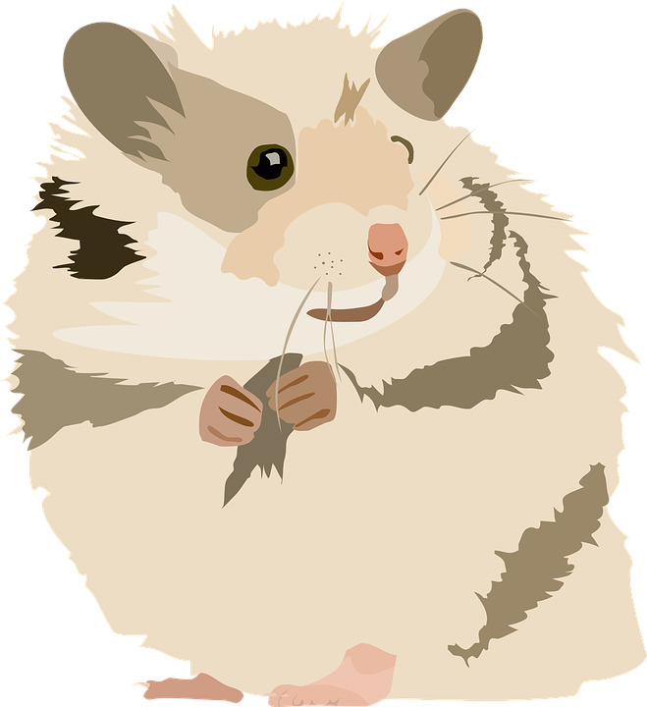
Plenary & Summary
Many pets live longer than you think.
Baby animals look cute but they need
lots of attention and special care.
Using a timeline, compare your ages with the average lifespan of an animal.
Can you imagine looking after an animal for the whole of the animal's life?
How old will you be when the animal is old?
What do you think you will be doing then?
Before taking on a pet, you need to think about looking after that animal for the rest of its life.
Life Spans
Cat: 12-14 years but can live up to 20!
Dog: Around 12-14 years
Gerbil: Up to 3 years
Goldfish: Up to 25 years
Rabbit: Up to 10 years
Budgies: Up to 10 years
Hamster: Up to 2 years
Guinea pig: Up to 7 years
Notes:
How long?
Explain to the class that many pets live longer than people think. Baby animals look cute but they need a lot of attention and special care. Like all babies, they grow up. Encourage pupils to appreciate that before taking on a pet, people need to think whether they can care for that animal for the rest of its life - however long that is.
Using a timeline, compare the pupils' ages with the average lifespan of an animal. Ask them the following questions:
Can they imagine looking after an animal for the whole of the animal's life?
How old will they be when the animal is old?
What do they think they will be doing then?

