Slide 1
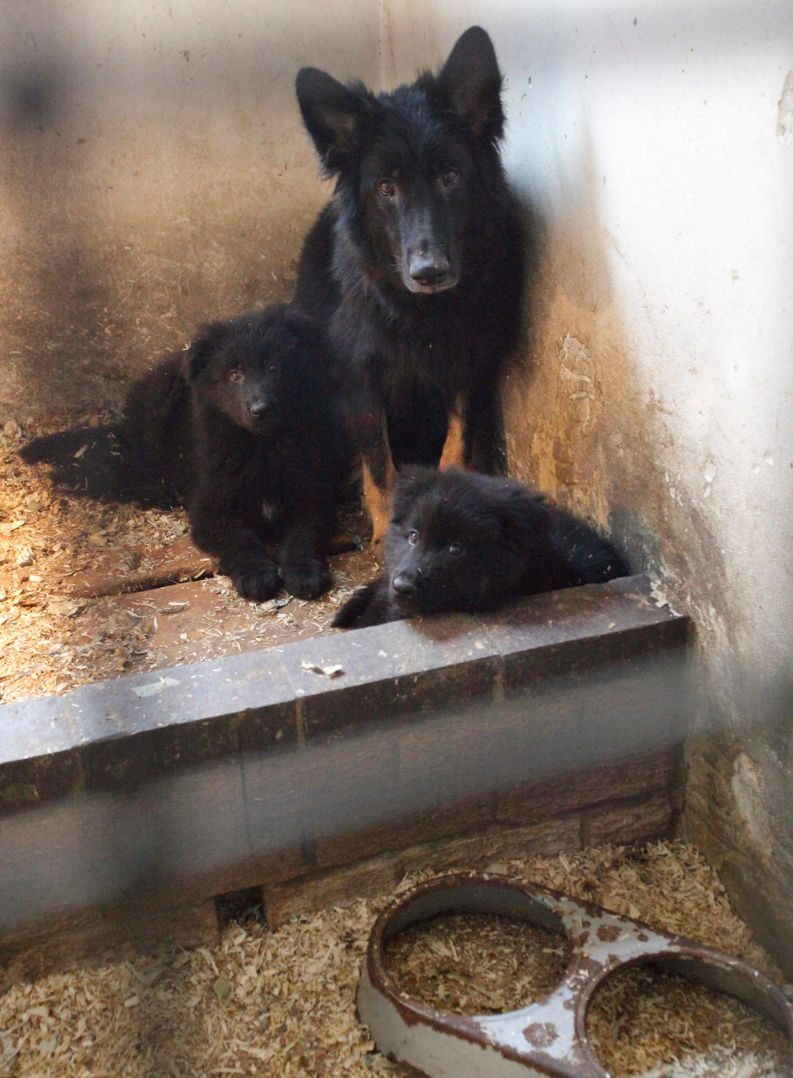
A Nation of Animal Lovers
INDIVIDUALLY - Can you think about:
Think about the difference between:
Deliberate Cruelty - intending to do something that hurts an animal
Neglect - failing to do something, which means that an animal suffers
Not Meeting Animal's Needs - not providing an animal with the things it really needs.
Animal Cruelty - What type of things do you think are cruel?
IN PAIRS - Can you think about:
Types of Cruelty - Make a list ensuring you provide examples.
Notes:
Ask the pupils to think about cruelty to animals. What types of things do they think are cruel?
Pupils often focus on deliberate cruelty - hitting and beating.
Once they have been given a range of examples, ask them to think about the difference between:
Deliberate cruelty - intending to do something that hurts an animal
Neglect - failing to do something, which means that an animal suffers
Not meeting an animal's needs - not providing an animal with the things it really needs.

Slide 2
Which Cruelty is Worse?
In Groups:
In groups of 4 you must decide which type of cruelty is worse than the others.
Is malice worse? Deliberately wanting to hurt something or someone?
What about neglecting the animal and showing no care or compassion?
How about not meeting some/all of the animals needs?
Join with another group who have decided a different form of cruelty is worse and debate your argument.
Can you justify your points?
Are you taking into consideration the animals feelings?
What about other reasons that may be out of the owners control?
Do you think the owner understands they are being cruel?
All of these types of cruelty result in unnecessary suffering.
Remember - You must consider thinking from an animal’s point of view.
Notes:
Do the pupils think one type of cruelty is worse than the other?
Ask the pupils to think from an animal's point of view. All of these types of cruelty result in unnecessary suffering.

Slide 3
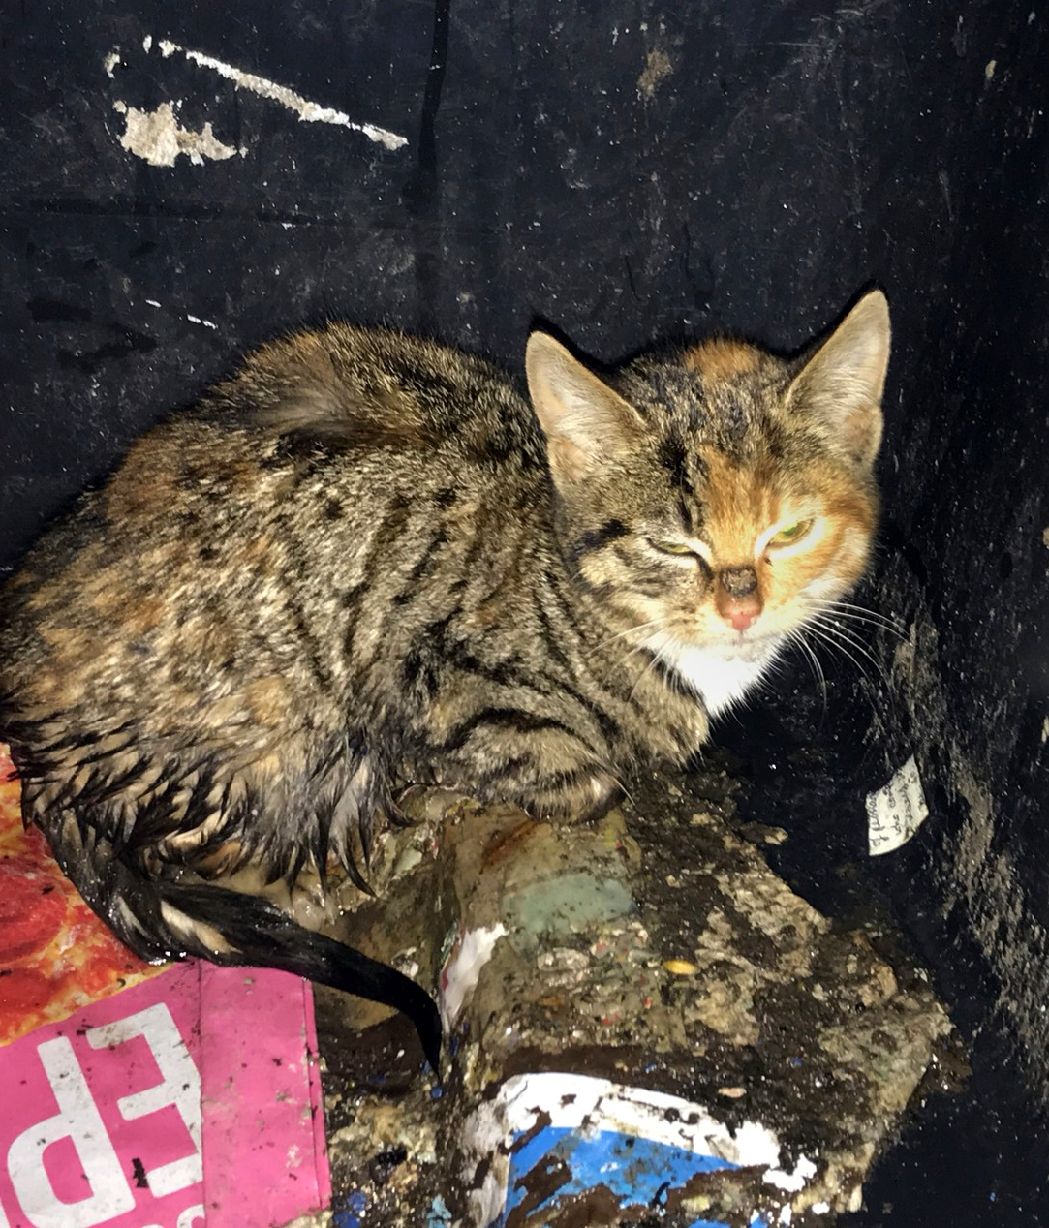
Case Studies
Read through the three Animals in need case studies which are based on real cases prosecuted by the RSPCA.
Each case involves deliberate cruelty, neglect and/or not meeting the needs of an animal.
Discuss each case study individually and decide whether you think it is deliberate cruelty, neglect or not meeting an animal’s needs.
Notes:
Use the factsheet Animals in need as a focus. The case studies are based on real cases prosecuted by the RSPCA. They involve deliberate cruelty, neglect and not meeting the needs of an animal (factsheet can be downloaded here).
Ask the groups of pupils to read through the factsheet. Each group could appoint a reader and leader.
Ask the pupils to discuss each case study in turn and decide whether they think it is deliberate cruelty, neglect or not meeting an animal's needs.
The answers are as follows:
Lucky the puppy - deliberate cruelty
Sadie the dog - neglect
A full house - not meeting an animal's needs

Slide 4
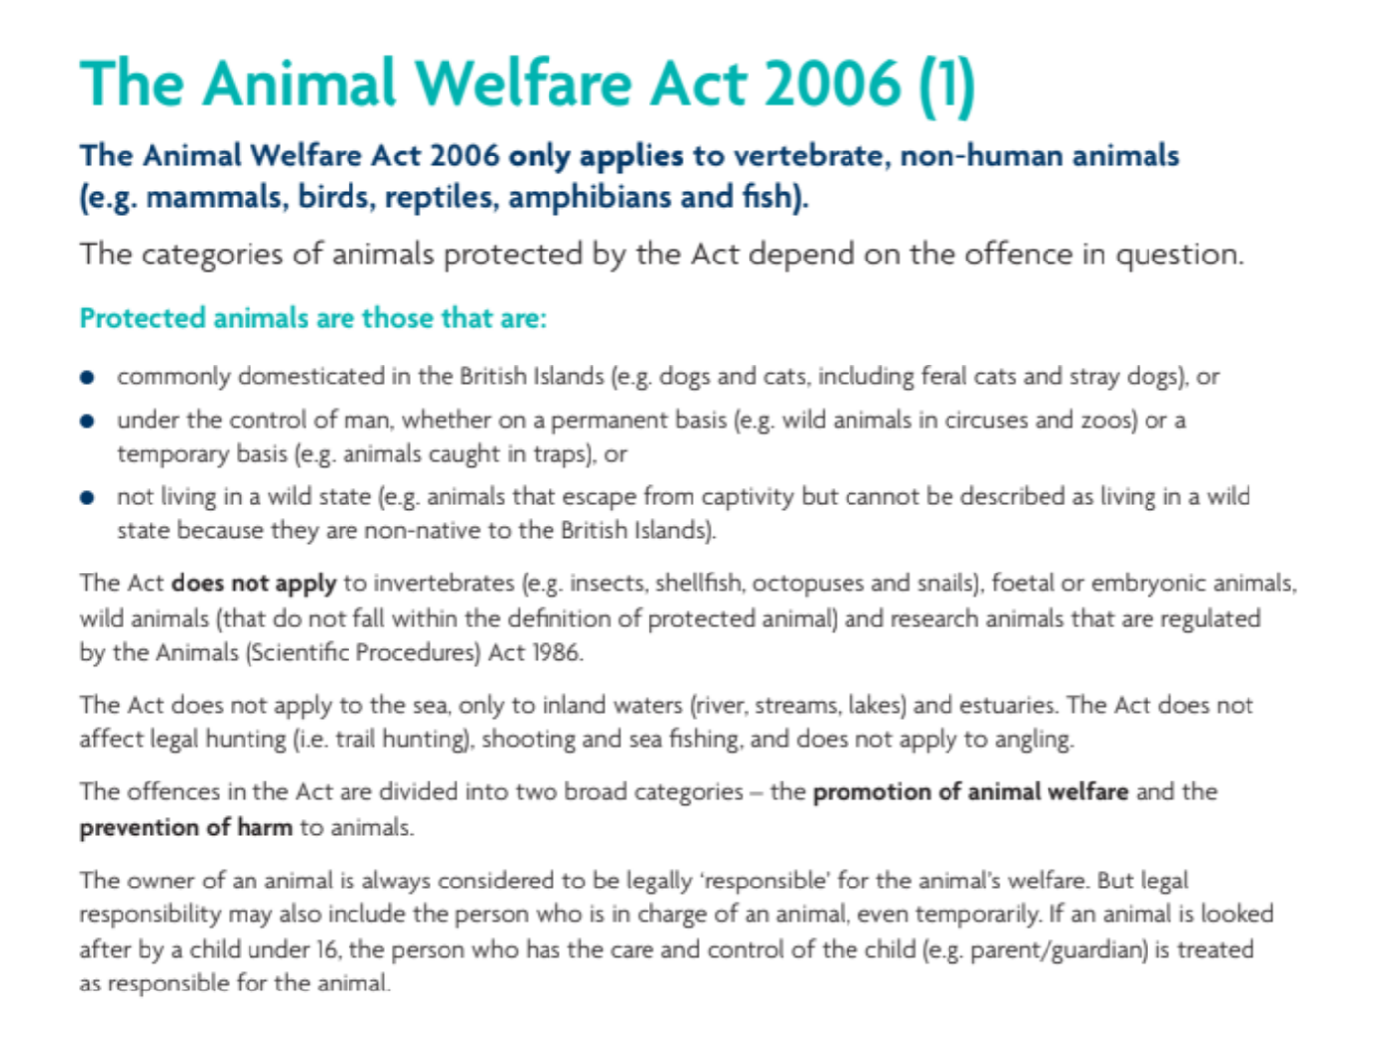
The Animal Welfare Act
Working in Pairs
Design a poster, leaflet or Presentation identifying the main aspects of the Act to teach others
Read through the Animal Welfare Act (2006) handout and highlight the most important aspects.
Every 30 seconds, someone somewhere in England and Wales dials 0300 1234 999 - the RSPCA's national cruelty and advice line - for help.
Notes:
Provide a handout to each pupil (available to download here)
Read through the Animal Welfare Act 2006 in pairs and highlight the most important aspects
Can you design a poster / leaflet / Presentation identifying the main aspects of the Act?

Slide 5
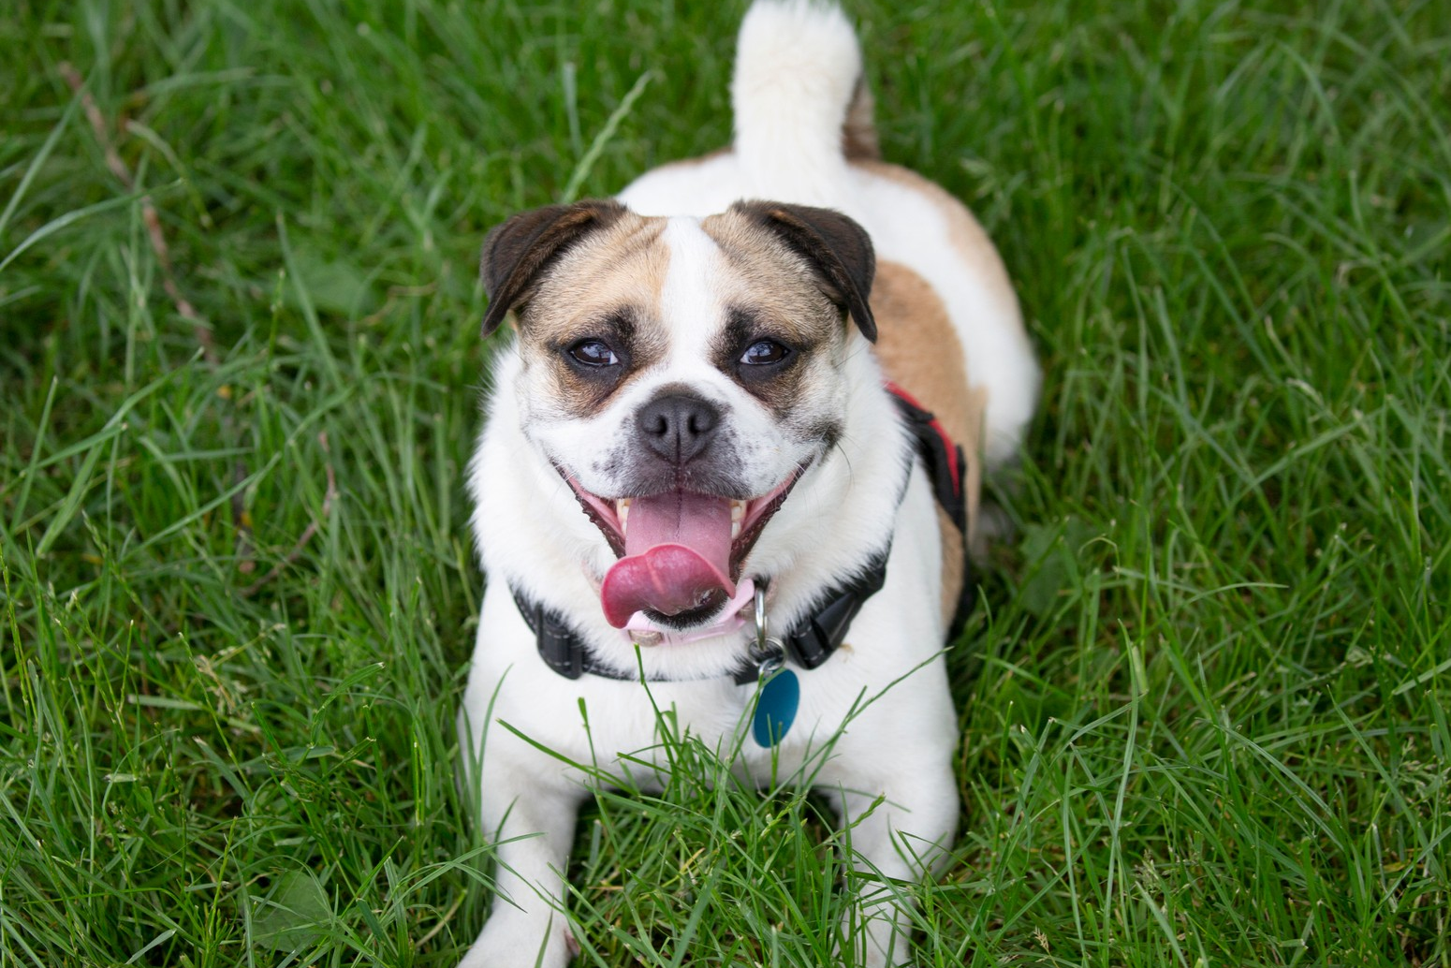
Plenary - Helping Animals
Case Studies
Having read and thought about the
previous case studies...
What would you most like to change about the way some people treat animals?
How would you like to help animals?
Did you Know
A person commits an animal welfare offence if they do not ensure that the needs of an animal for which they are responsible are met.
Most of the cases seen by RSPCA inspectors are neglect caused by people who do not know how to look after animals properly. Sadly, some people are also deliberately cruel to animals.
Notes:
As the pupils have read and thought about the case studies ask them to think about
What would they most like to change about the way some people treat animals?
How would they like to help animals?
More ‘Did you Know’ facts are available on the lesson plan

