Slide 1
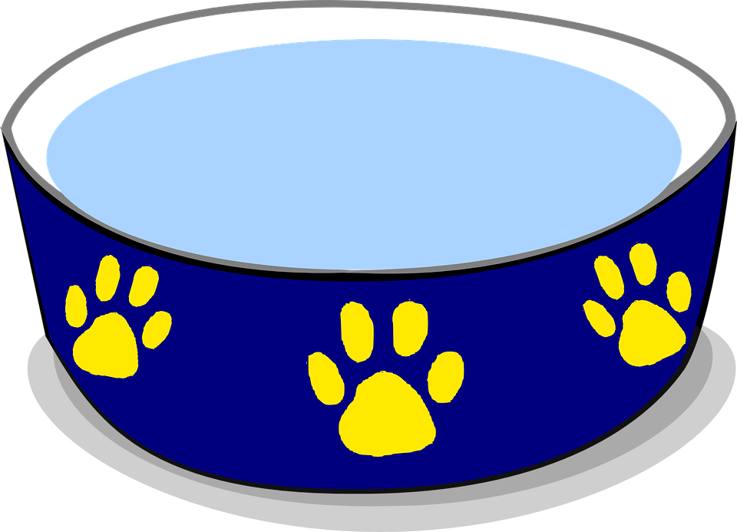
Caring For Our Pets
Starter
The 5 Welfare Needs
What are they?
Who has a pet at home?
What do you have to do to look after your pet?
Can you tell the person sitting next to you about him or her?
Anyone who looks after animals must make sure that they have all of these things all of the time.
Can somebody tell the class about their partners pet?
Notes:
Those that do should describe their pet and what they have to do to look after him/her to the person sitting next to them.
Ask some of the children who have done some good listening to describe what their partner told them about their pet.
Using the five welfare needs symbols, establish with the children what are the five basic needs of pet animals.
Explain that anyone who looks after animals must make sure that they have all of these things all of the time.

Slide 2
Our Classroom Pet
Let’s meet our Classroom Pet!
Today we will learn:
- How to pick up or handle an animal correctly. ONLY touch or pick up an animal if its adult owner says that it is OK.
- How to stroke an animal on its side and stroke the same way that the fur grows.
- Never drop an animal or stare into its face.
Task: Let’s learn how to groom our pet. You will need to brush him the correct way and why it is important that some animals must be groomed.
Remember we must always BE GENTLE so that we don’t hurt him.
Sing “My Dog Ben”
Notes:
Introduce a toy animal(s) as the classroom pet for the day.
Using this animal, children learn (using the toy animal but linking to real life pets)
How to pick up or handle it correctly so that neither they nor the animal gets scared or hurt. The adult stresses how important it is to only touch or pick up an animal if its adult owner says that it is alright to do so
How to stroke the animal on its side and stroke the same way that the fur grows so the animal doesn’t feel uncomfortable
They must be gentle so that they don’t hurt the animal
They must not drop any small animals that they pick up.
They should not stare directly into a dog’s face.
Using an appropriate brush, children groom the animal, taking care to only brush the same way that the fur grows. Children learn that some pets need to be groomed regularly to keep their fur clean and healthy.
Optional -Sing the song My dog Ben (download from Caring for our pets)

Slide 3
Memory Game
Extension:
A group of pupils listen to the story about Smoky’s new home.
Can they tell the story correctly using the props to other pupils?
Task:
Take it in turn to hold the pet.
You must list one thing that you need to give that pet every single day for it to stay Happy and Healthy
Pass the pet onto the next person.
They must remember what you said and think of one more thing.
Example
Pupil 1: “I have a dog and I need to take it for a walk..”
Pupil 2: “I have a dog and I need to take it for a walk AND ….”
Notes:
Using a toy pet, the children take it in turns to hold the pet and add to the list of what they need to do to look after it. For example, the first child says: “I have got a cat and I need to… give him/her cat food every day.” The second child takes the cat and says: “I have got a cat and I need to … give him/her cat food every day and make sure he/she has clean water all the time.” Continue until the children have met all the needs of the cat (see teachers’ notes Pets’ needs).
Extension - Storytelling including the activity sheets Smoky’s new home (Images & Activity Sheets - see Downloads tab), toy rabbits, an RSPCA inspector hat and a ‘reserved’ sign. A small group of children listen to and then retell the story of Smoky, using the props provided.

Slide 4
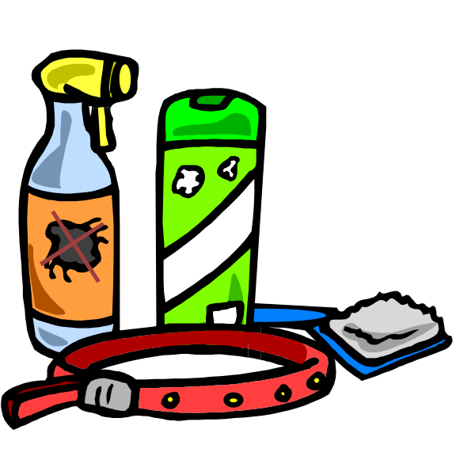
Pet Care Items
Task
Vet Care Corner
Let’s go and play in our ‘Vet Care Corner’ - Can you tell me which medicine is for animals or for humans? How important is it that we take our animals to the vets if they are poorly?
Let’s take a look at some animal items. What are they?
Can you sort the items matching them with which pet they are for?
Notes:
Part 3 - Put out a selection of pet care items (see teachers’ notes Pet care items), pet photos (see collection of images Pets) and some sorting rings. Children should sort the items according to which pet they are for or can just name or explore the items.
Create a veterinary or animal welfare clinic as a role-play area. Include some toy animals, toy syringes, stethoscopes, bandages, empty bottles and packets from veterinary medicines, an area for keeping animals that need to stay in, a waiting area, etc (see teachers’ notes Vet clinic role play area for a suggested layout). Stress that the medicines given to animals are special and animals should never be given medicine that is meant for humans.

Slide 5
Plenary & Homework
Inspector Phone Call
Homework 1
One pupil at a time will take our classroom pet home to look after overnight.
You must make a note (with adult help) what jobs you had to do for the pet during this time.
“An animal is not being looked after properly?!”
Quick!
Put on your RSPCA hats and let’s go and explore where the animal lives!
What part of this pet’s care is missing?
What can we do to improve the situation?
Homework 2 - Optional
Can you bring a photo of a pet that you know and describe him/her to the rest of the class? These photos can be put up on the wall for display.
Notes:
An adult takes a ‘phone call’ about a pet that is not being looked after properly (for suggestions see teachers’ notes Animals in need). He/she invites a group of children to put on their RSPCA hats and accompany them to where the animal lives, where they find a toy animal. The children give suggestions as to what aspects of the pet’s care are lacking. They discuss what needs to be done to improve the situation. They can then return later to check for an improvement.
Homework - One of the toy pets can be taken home overnight in turn by the children. Each child can ask an adult at home to help them to record what jobs they did to care for the pet during its time with them.
Homework 2 - Ask the children to bring in a photo of either their own pet or a pet that they know and describe him/her to the rest of the class. These could then form part of a display

