Slide 1
Exotic Animals as Pets
What is an exotic pet?
Starter Activity
Working in pairs create a mind map of what an exotic (non-domestic) pet is.
Did you know it is difficult to give a clear definition of ‘exotic’.
They are completely reliant on their keeper to provide an appropriate environment and food to stay healthy and to exhibit natural behaviours
Any animal that is not native to the country where it is kept.
Why do you think people keep exotic pets?
Notes:
What is an exotic pet?
Any animal that is not native to the country where it is kept in captivity can be called an exotic (non-domestic) animal. Generally, these animals are not adapted to the climate and wild environment in the country where they are kept.
Working in groups or pairs, ask the class to mind map what an exotic (non-domestic) pet is.
They can then feed back to the group the types of animals they think exotic pets may be. For example:
spiders, such as tarantulas
frogs, toads, salamanders and newts from tropical countries
green iguanas, geckos and chameleons
exotic snakes
tortoises and terrapins
parrots and other exotic birds
monkeys
chinchillas, chipmunks and gerbils.
Why does the class think that people keep exotic pets?

Slide 2
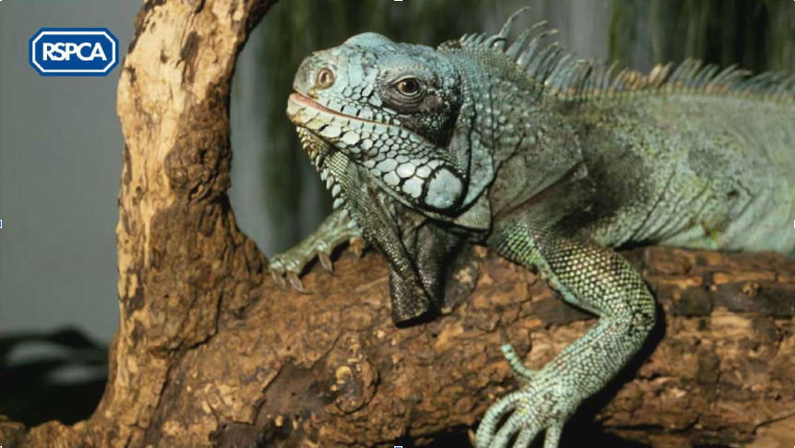
Exotic Animal - Iguana
Did you know
All pets, including exotic animals, require proper care and attention. But exotics can be more expensive to feed and look after properly and they often require specialist living conditions.
Think about the conditions iguanas are used to in these places.
How do you think iguanas feel when they come to the UK? How are the conditions different here?
Iguanas come from tropical places in the Caribbean and in Central and South America
Some owners keep exotic animals in unsuitable conditions, which cause a variety of illnesses and injuries. It can also be difficult and costly to find a vet who is experienced in treating these animals.
Notes:
Ask the pupils to think about the conditions iguanas are used to in these places - for example - heat, sun, monsoon conditions.
How do the pupils think iguanas feel when they come to the UK? How are conditions different here?

Slide 3
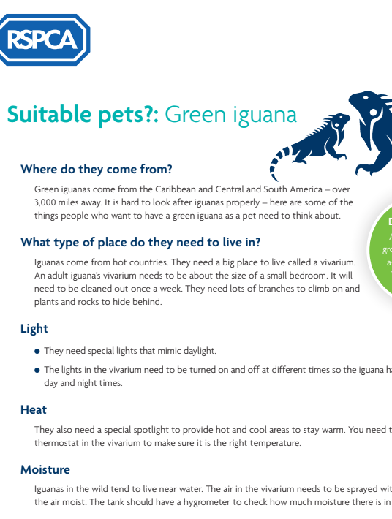
Looking after an Exotic Pet
Task
1. Read through the Suitable pets fact sheet and make notes of all the different things you need to buy to look after a green iguana properly.
2. Feedback to the class and come up with a ‘class list of suggestions’ e.g vivarium
3. In pairs, compare a common pet such as a dog or cat with an iguana.
What are the differences? What do dogs need to be happy and healthy and what do iguanas need?
Notes:
Read through the factsheet Suitable pets (download here) with the pupils and ask them to make a note of all the different things you need to buy to look after a green iguana properly.
Ask the class to feedback what they noted. Write a list of their suggestions, which might include:
vivarium, thermostat, hygrometer (to measure humidity), special lights, heat sources, food
water, plants and branches.
In pairs, ask the pupils to compare a common pet, such as a dog, with an iguana. What are the differences?

Slide 4
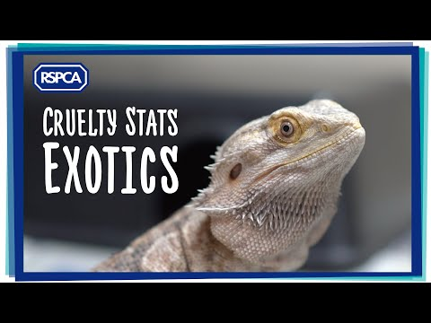
To find out more about exotic pets head to the following website to find various care sheets based around exotics www.rspca.org.uk/adviceandwelfare/pets/other
RSPCA Exotic Animals YouTube
To watch more YouTube clips click here.
Notes:
Watch the following video and ask the class to discuss how this makes them feel and how they think they could end animal abandonment in exotic pets in particular.
If pupil want to research more around exotic pets, use the website shown on the slide.

Slide 5
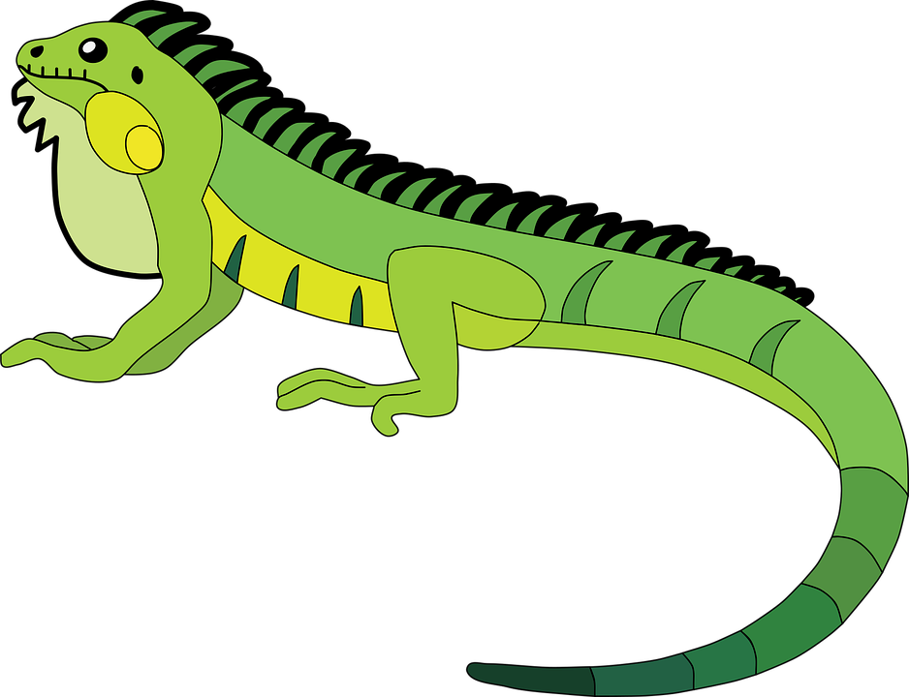
Plenary & Extension
Are exotic animals suitable pets?
In groups, you need to decide whether you think exotic animals such as iguanas make good pets.
Extension Activity
Can you write to the chief environmental officer at your local authority and suggest ways that pet shops could promote responsible pet ownership.
Think of things such as training staff appropriately in exotics
Licensing standards for pet shops
Did you know?
Can you share your experiences of exotic pets? Do you know someone who owns one? Do you have an exotic pet yourself?
People often buy young animals without finding out how big they will grow and how long they will live.
As a result, pet owners might abandon or neglect the animals when they reach their full size
Notes:
After feeding back these ideas to the class, ask groups of pupils to decide whether they think animals such as iguanas make good pets and to share their experiences. Do they know someone who owns one? Do they have an exotic pet themselves?
Extension - Ask pupils to write to the chief environmental officer at their local authority and suggest ways that pet shops could promote responsible pet ownership. For example, pet shop staff should be trained in exotics' care so they can give customers detailed information when they buy exotic pets. The local authority could set strict licensing standards for pet shops and visit them regularly to ensure the guidelines are being followed.

