Slide 1


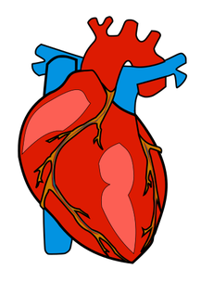
Basic Needs
Starter
Think about what makes you happy?
Provide one suggestion.
Let’s talk about our answers and note them on the board.
2 minutes
Now let's think of what makes you healthy?
What is the difference between things we WANT and things we NEED?
Notes:
Ask pupils to think, for two minutes, about what makes them happy. Ask everyone in the class to make a suggestion.
Write or draw all the answers on the board.
Repeat this, asking pupils to think what makes them healthy.
Can they identify the difference between what we may want and what we may need?

Slide 2

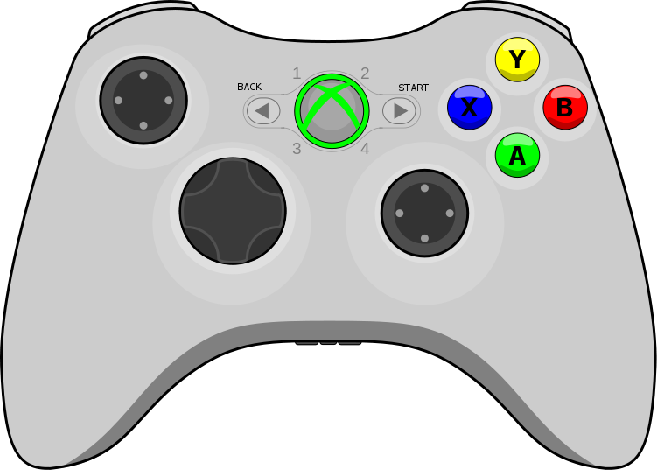


Human Needs
As you have identified what the difference is between WANTING and NEEDING something, we are now going to look at what humans NEED.
If you think of any extra, add these in too!
As a Class:
Can we agree on a set of basic human needs?
Question
Take a look at the list.
Which answers are needs rather than wants?
What do humans need to be happy and healthy?
Notes:
Working in small groups, ask pupils to look at the list on the board and pick out which answers they think are basic needs, rather than things that they like or enjoy. They can add ideas to their lists if they think of something that hasn't been mentioned.
Come back together as a class and discuss the lists. Try to agree on a set of basic human needs and write or draw these on the board or flipchart.

Slide 3
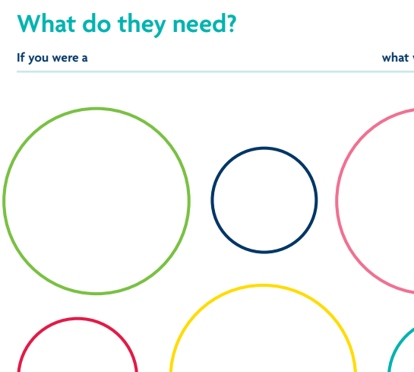
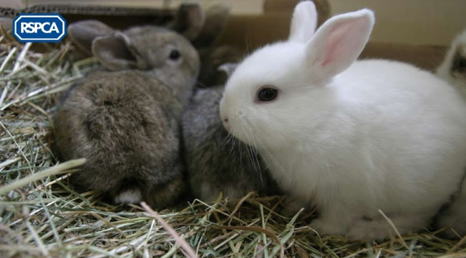





Animals Need
Who has a pet in here?
Can you tell me about your pet?
Look at the ‘Human Needs’ list and now your ‘Animal Needs’ What have you noticed?
Question
What do animals need to be happy and healthy?
Can anyone identify what the 5 Welfare Needs of animals are?
Write or draw your answers on the worksheet.
Notes:
Pupils should now think about what animals need to be happy and healthy. Refer to factsheet The five welfare needs Ask pupils to suggest things that they think animals need. It may help to talk about a specific animal that they have experience of, such as a pet or farm animal. They can write or draw their answers on the worksheet What do they need?.
Compare the two lists of needs you have written and discuss. Pupils should realise that the lists are similar.
Depending on the class ability, you may be able to put together separate lists of needs for pets, farm animals and wildlife. Again, make sure that pupils understand the difference between 'wants' and 'needs'.

Slide 4

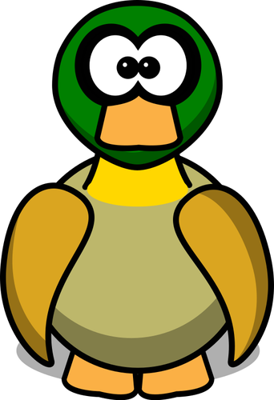


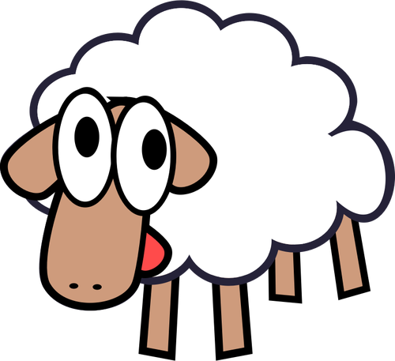

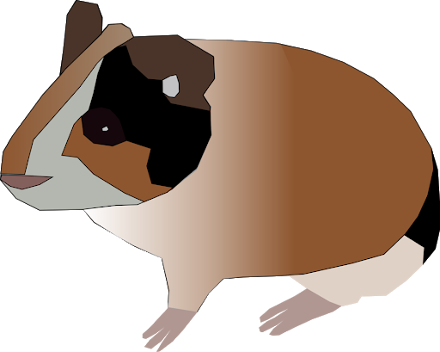
Animal Interviews
Choose one of the following animals:
Example
“What do you like to eat?”
I really like fresh fruit and vegetables but...
In pairs, you are going to interview this animal.
Think About:
What questions would you like to ask?
What would the animals say?
Notes:
Pupils choose one of the animals. Working in pairs or small groups, the pupils should imagine that they are going to interview the animals.
What questions would they like to ask? What would the animals say? What would you like to ask the animals? in the form of a conversation.
So they would write their question, followed by the animal's answer.
Extension → Encourage them to act out the interviews in front of the rest of the class, some pupils playing the part of the animals and some playing the part of the interviewers - then swap roles.
(This could form the basis of a class assembly on animal welfare - pupils could begin with role play and then go on to explain more about how we should all look after animals and about the work of the RSPCA).

Slide 5

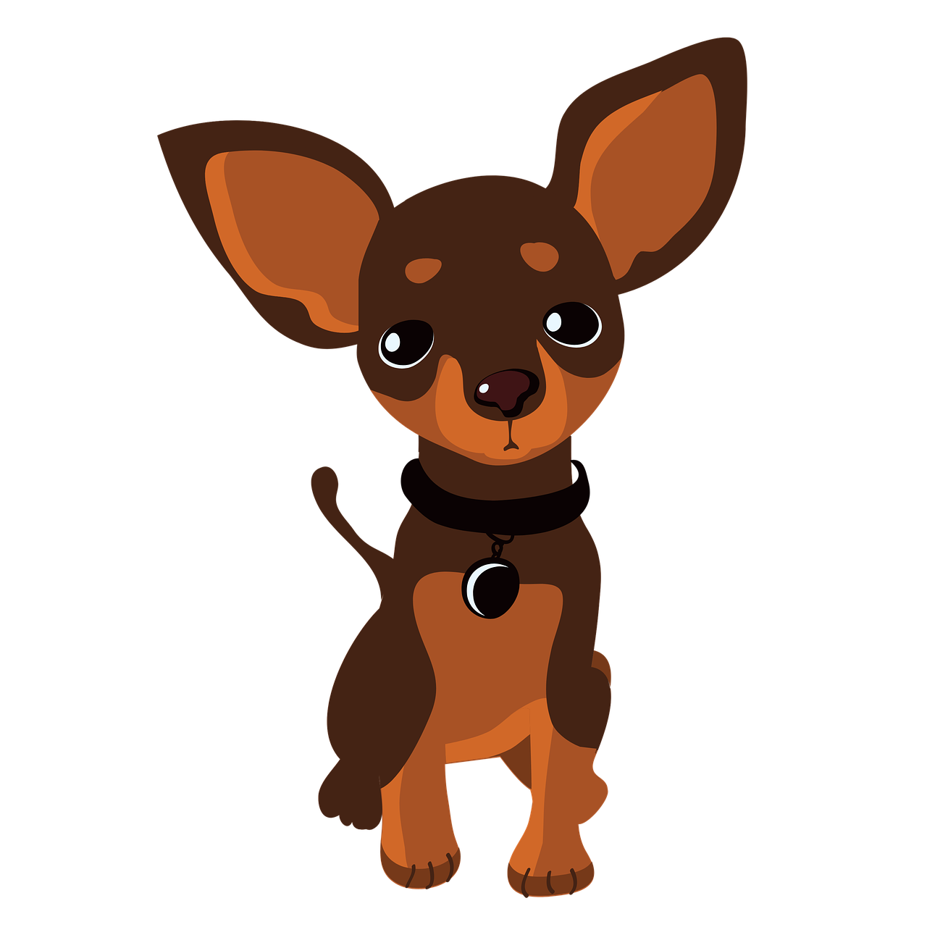

Plenary & Homework
Questions
What have you learnt from today’s lesson?
How did you feel thinking about animals needs?
Do you think you will do anything differently now after this?
Did you know?!
It costs around £700 a year in the UK to keep an average-sized dog.
More than 900 million farm animals are produced every year in the UK.
Homework
Can you design and create a ‘What do animals need’ poster to display on our classroom wall.
You can use images of your own pets.
£700 a year!
If I live until I am 10 years old, I will cost £7000
Notes:
Plenary - Ask pupils what they have learned from the activity. How did they feel thinking about animal needs? Is there anything they will do differently as a result?
Homework (optional) - Pupils can design and create a What do animals need? poster.
They could use photos of their pets, or of animals that they particularly like, and add their own text.

