Slide 1
Campaigning for Animal Welfare
What makes a campaign?
Look at the following RSPCA campaign posters.
Which parts of the posters do you think are most effective?
Make notes!
In today’s lesson you will be developing your own animal welfare campaign.
Are there any campaigns that you already know about?
Notes:
What makes a campaign?
Show students a selection of RSPCA campaign posters (more available online). Ask them what aspects of the posters they think are effective. (3 Images will come in 1 by 1 as you click through)
Explain to students that they are going to develop their own animal welfare campaign.
Discuss any campaigns they already know about.

Slide 2
Slogans & Headings
Task 1:
Using the ‘Campaign Posters’ worksheet can you come up with appropriate slogans and/or headings for each of the five posters?
Task 3:
Decide on your target audience by completing the ‘Who do we need to influence?’ worksheet in groups of 5.
Decide which of those people you could try and influence with your campaign
Task 2:
Decide on an issue for your campaign from the following website
Did you know?
The Animal Welfare Act 2006 came about as a result of campaigning by animal welfare groups such as the RSPCA. It has changed the lives of millions of animals
Notes:
Give each group of students the worksheets Campaign poster (1-5) (available to download here) and ask them to create appropriate slogans or headings for each poster.
The campaign journey
Groups decide on an issue for their campaign - RSPCA Campaigns website
The students need to decide on their target audience. They play ‘Who do we need to influence?’ in groups of five and then decide which of those people they could try to influence with their campaign.
Read more about The Animal Welfare Act on the Defra website and in the Animal Welfare Act 2006 teachers' notes.

Slide 3
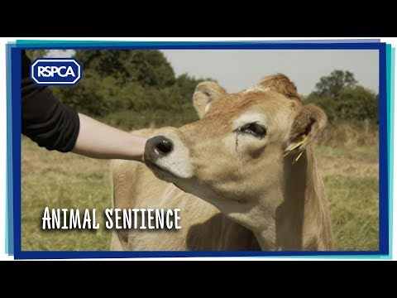
Animals are NOT objects
Watch the Animal Sentience Video
This video clip is based around the campaign ‘Animals are not objects’.
How does this campaign make you feel?
Do you agree or disagree?
What else could the RSPCA do to campaign this issue?

Slide 4
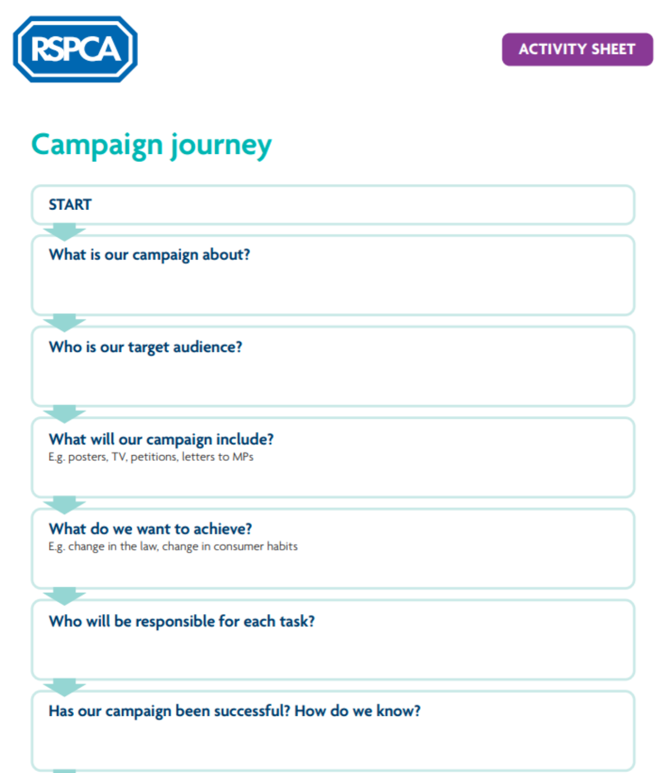
Planning your Campaign
Task
3. Practice presenting your campaign in preparation to present in front of the class
- Do you have any criteria to follow?
1. In groups, start planning your campaign using the first few steps on the Campaign journey activity sheet.
2. Research and produce materials for your campaign. What will your campaign include?
- Posters?
- Letters?
- Video Clips?
- Petitions?
Notes:
Groups plan their campaign, using the first few steps on the Campaign journey activity sheet
Pupils have some time to research and produce the materials for their campaign.
At the end of the research and production period, groups practice presenting their campaigns (they will be required to do this in front of the class later on).

Slide 5
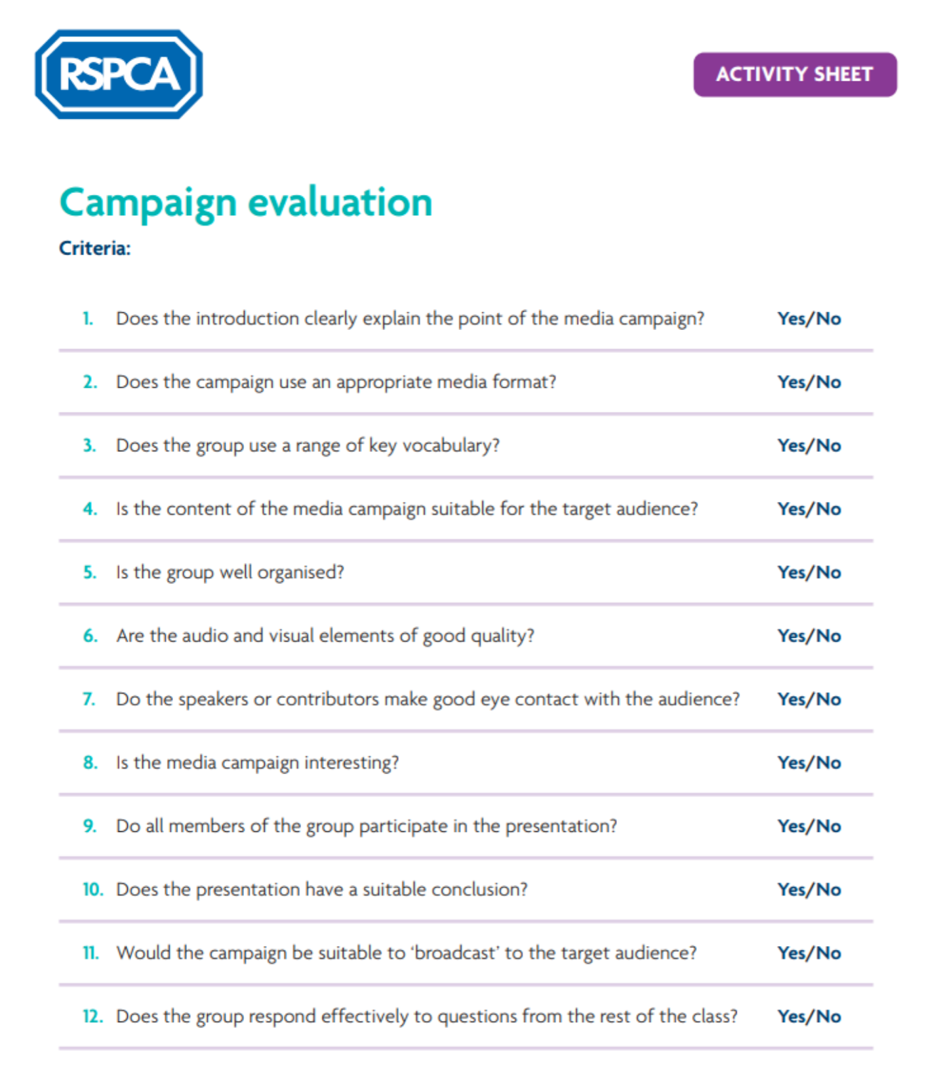
Plenary & Assessment
Finally: You must now assess your classmates’ presentation campaigns.
Whose campaign was most effective?
As a class, you must now vote and discuss which campaign was most effective.
Can you justify your decision?
Use the ‘Evaluation Sheet’ for extra guidance.
Extension Task: Complete the ‘Pets and the law quiz’
What Next?
Create a class display using your campaign work to showcase to other pupils in the school.
Notes:
The students should assess their classmates’ presentations and campaigns using the Campaign evaluation sheet
Conduct a class vote/discussion on which campaign was most effective.
Optional - Create a display - Using the groups work and Information on the different pressure groups so highlight the issues to the rest of the school.
Extension Task - Complete the ‘Pets and the law quiz’ (quiz and answers are available to download from here)
Assessment: Student presentations can be assessed by the teacher, alongside peer evaluation.

