Slide 1

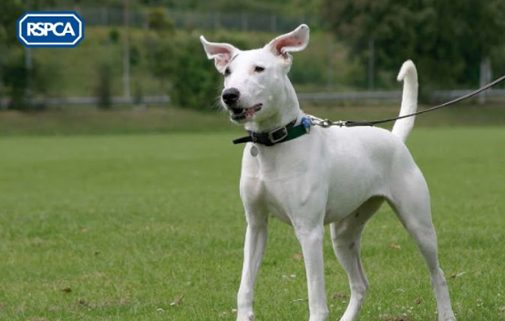



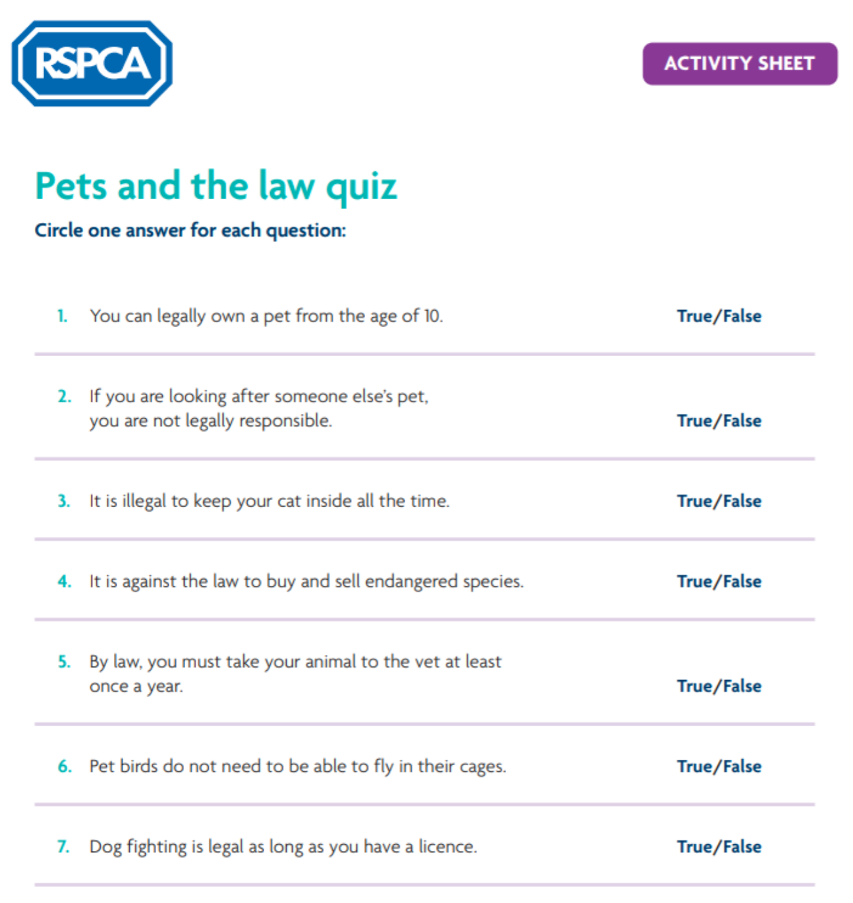


Rights & Responsibilities
Can you identify all 5 of the Welfare Needs?
Starter
Complete the Quiz
Pets and the law
Question
What do you think all pets need to be happy and healthy?
Animal Welfare Act -
5 Welfare Needs
Notes:
Pupils complete the Pets and the law quiz (questions & answers can be downloaded here).
Ask the students to consider what all pets need to be happy and healthy.
Introduce the five welfare needs as defined in The Animal Welfare Act 2006 (you can download a print out of this for the pupils)

Slide 2



Task - Identifying & Discussing Issues
Task 1
Read the factsheet Big Cat in Peckham in small groups or pairs.
Task 3
Read the factsheet Non-domestic (exotic) pets
Task 2
Now read the RSPCA Statement and discuss the issues from both documents.
What are your thoughts on people keeping exotic animals as pets?
Notes:
Read the factsheet Big cat in Peckham (available to download from here).
Read the RSPCA statement, (available here) and discuss the issues from both.
Read the factsheet Non-domestic (exotic) pets (available here)
Extra Information: Few reptile species are bred regularly on a large commercial scale in the UK. Most green iguanas are imported as hatchlings from countries in South America, Africa and Indonesia. However, many breeders are able to support their hobby by breeding and selling the young of many other species.

Slide 3
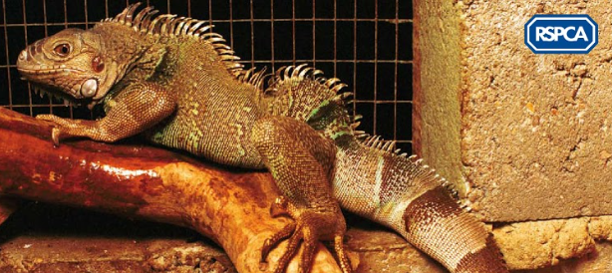


Scenario Work
There is a local problem with people buying non-domestic pets and then struggling to meet their needs.
The local authority and the RSPCA are having to rescue and rehome a number of animals.
A number of young people are buying these pets but they don't always have the knowledge, time and money to care for them properly.
The main issue is that people don't know or understand their responsibilities under the
Animal Welfare Act 2006.
Some of them are under 16 and are too young to legally buy a pet.
Notes:
Read the scenario above with the class.
(see The Animal Welfare Act 2006 teachers’ notes and lesson plan for more information both available to download here)

Slide 4

Scenario Work
Once you have been given your ‘role’, discuss the issue from this point of view
It has been decided that a local forum will be set up to address the problem
In groups of 5, use the role play cards to form five expert ‘groups’ that will send a representative to the forum
The chairperson runs the role play using the Agenda
The 5 groups are:
RSPCA
Environmental services officer
Owner of an iguana
Breeder of non-domestic (exotic) animals
Local person who will act as chairperson
END GOAL - The forum should create an action plan to resolve the issue
Notes:
Using the role play cards (available to download here) students form five expert groups that will send a representative to the forum.
Groups discuss the issue from their point of view. They decide what they will contribute to the forum.
Using the Animal welfare forum agenda (available to download here) the chairperson runs the role play. The forum creates an action plan to resolve the issue.
Extension - Regroup with others to form several mixed forums.

Slide 5


Plenary & Summary
Questions to think about:
What measures would you put in place to ensure that only those people who were able to provide the care that pets need were able to purchase them?
Would these measures require a new law or do you think these can be achieved using alternatives methods?
In your groups of 5, present your action plan to the class.
Who do you think is responsible for ensuring the needs of pets are met? Why?
Extension
Could you set up an animal welfare forum for animal welfare issues in the school? Perhaps it could be part of the school council?
Notes:
Groups present their action plan to the class.
Who do the students think is responsible for ensuring the needs of pets are met? Why?
What measures would they put in place to ensure that only those people who were able to provide the care that pets need were able to purchase them? Would these measures require a new law or do the students think these can be achieved using alternatives methods?
(for example, a voluntary code of practice? A voluntary code of practice is a set of guidelines that organisations choose to sign up to, but it is not compulsory for all)
Extension - Could you set up an animal welfare forum for animal welfare issues in the school? Perhaps it could be part of the school council?

